Slide 1
National Institute of Health (NIH) Helping End Addiction Long-term (HEAL)
Common Data Elements (CDE) Program
Pain Course 2024
Notes:
Hi, my name is Giulia Bova, and I work in the Office of Pain Policy and Planning at the National Institute of Health. Today, myself and my colleagues Carolyn Conlin and Anthony Jeuhne, are going to present an overview of the Helping to End Addiction Long-Term (or HEAL) Common Data Elements program, a program meant to harmonize data among HEAL-funded studies involving human subjects.

Slide 2
Objectives
Explain the biopsychosocial model of pain and its importance in assessing pain in research and clinical practice
Understand the domains required of HEAL-funded pain studies involving human subjects
Understand how and why HEAL standardized domain assessments across HEAL-funded studies
Access and utilize the HEAL core CDEs and supplemental CDEs through the HEAL CDE Repository
Understand the purpose of the HEAL Data Ecosystem, and how to access and use the tool
Notes:
The objectives for this lesson are to explain the biopsychosocial model of pain, and why this model is important when assessing pain; to introduce everyone to the domains that are required to be measured as part of the HEAL CDE core for studies involving human subjects; to explain why the NIH HEAL initiative decided to standardize domains, and the process they undertook to do so; to demonstrate for participants how to actually access and use the core questionnaires through the CDE repository; and lastly, to explain and demonstrate the HEAL Data Ecosystem, a useful tool for all pain researchers to conduct secondary data analyses.

Slide 3
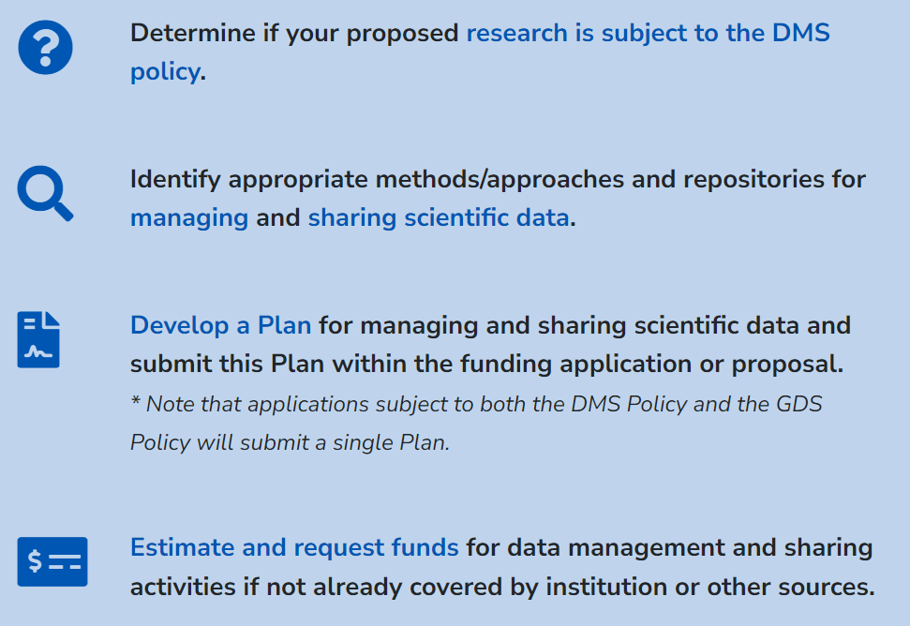
Background: NIH Data Sharing Policy
NIH Policy for Data Management and Sharing (DMS) - 2023
  The NIH Institutes and Centers (ICs) may have specific data standards to enable interoperability (ability for systems to exchange and use information)
  For example, HEAL-funded studies have their own DMS
    HEAL- funded clinical pain studies are required to use the HEAL Common Data Elements (CDEs)
Notes:
To provide a bit of context for the HEAL CDE program, it's important to mention that NIH has a Data Management and Sharing Policy, effective as of January 2023. Any investigator who receives funding from NIH should ensure that they are in compliance with the NIH data sharing policy, as well as any specific data sharing requirements of the Institute or Center from which they received funding.
The HEAL initiative has its own data sharing policy, and use of the common data elements is just one requirement of that policy, which is linked here.

Slide 4
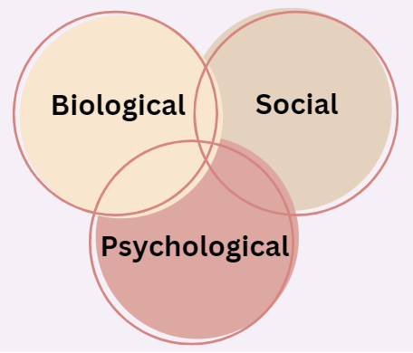
Background: Biopsychosocial Model
Biological, Psychological and Social factors contribute to a person's pain experience
Biological: Factors/changes in the body
Psychological: The mind and a person's experiences with others
Social: Environmental conditions
A holistic pain assessment goes beyond measuring pain intensity.
Trials should consider using outcome measures that assess participants from a biopsychosocial perspective.
Notes:
When we think about how to measure and assess pain, it's important to keep in mind that pain is not just a physical experience. A person's experience of pain encompasses biological, psychological, and social factors, which means that assessing pain in research must also account for these various factors, and how they can interact with each other. When creating the Common Data Elements program, NIH sought to move beyond just assessing pain intensity, and consider a holistic approach to measuring pain.

Slide 5
Key Terms
Common Data Element (CDE): standardized, precisely defined question that is paired with a set of specific allowable responses, and used systematically across different studies to ensure consistent data collection
Domain or Patient Reported Outcome (PRO): a broad aspect of a health condition/disease that can be measured (“what” to assess); sometimes called "outcomes"
Patient Reported Outcome Measure (PROM): measurement tool/questionnaire/case report form used to assess a domain/outcome
HEAL Core CDEs: a minimal and defined set of patient reported outcome screening tools for each pain domain that are required to be collected by all HEAL-funded pain studies involving human subjects
Sources: https://heal.nih.gov/data/common-data-elements
https://www.ncbi.nlm.nih.gov/pmc/articles/PMC5499094/
Notes:
Before explaining the process of developing CDEs and the required CDEs, we would like to point out a few relevant terms here. A Common Data Element is a standardized, precisely defined question that is paired with a set of specific allowable responses, and CDEs are used systematically across studies so that data can be collected in a consistent and comparable way.
A domain, also often referred to a patient-reported outcome, or PRO, is broad aspect of a heath condition that can be measured. Outcomes are “what” to assess in a study.
On the other hand, a Patient-Reported Outcome Measure, or PROM, indicates “how” to measure an outcome or domain through a measurement tool, such as a questionnaire. For the HEAL CDE program, we use the term Case Report Form, or CRF, for questionnaires.
Lastly, the HEAL Core CDEs refers to the minimal and defined set of patient-reported outcome screening tools for the 10 domains that are required to be collected by all HEAL-funded pain studies that involve human subjects. Researchers usually will also collect additional data outside of these core domains, that are relevant to their study aims, area of research, or study populations.

Slide 6
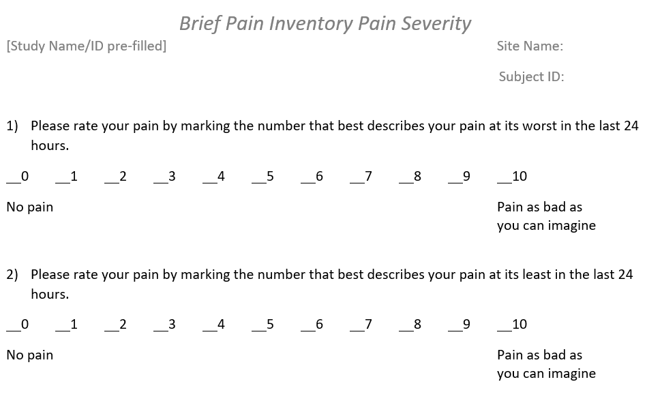
Key Terms: Examples
Patient-Reported Outcome Measure (PROM): Brief Pain Inventory
CDEs: Individual questions with set of permissible values
Note: PROMs are referred to "Case Report Forms" or "CRFs" in the HEAL CDE resources.
Notes:
This is an example of a Case Report Form, or Patient-Reported Outcome Measure. The PROM is called the Brief Pain Inventory, and the CDEs are the individual questions that are standardized with a specific set of permissible values.

Slide 7
Example of a Common Data Element (CDE)
CRF Question # | CDE Name | Variable Name | Definition | Short Description | Additional Notes (Question Text) | Permissible Values | PV Description | Data Type | Disease Specific Instructions | Disease Specific References | Population | Classification | CRF Name
1 | Brief Pain Inventory (BPI) - worst pain rating scale | BPIWorstPainRatingScl | Scale indicating the rating of the worst pain, as part of the Brief Pain Inventory (BPI) form. | Scale indicating the rating of the worst pain, as part of the Brief Pain Inventory (BPI) form. | Please rate your pain by marking the number that best describes your pain at its worst in the last 24 hours. | 0;1;2;3;4;5;6;7;8;9;10 | 0 = No pain;10 = Pain as bad as you can imagine | Numeric Values | Mark the one number that describes your pain at its worst during the past 24 hours. Use the scale of 0 = No pain and 10 = Pain as bad as you can imagine | Daut R. et al. Development of the Wisconsin Brief Pain Questionnaire to assess pain in cancer and other diseases. Pain, 1983; 17: 197-210. Keller et al. Validity of the brief pain inventory for use in documenting the outcomes of patients with noncancer pain. Clin J Pain 2004; 20: 309-318. | Adult;Pediatric | Core | Brief Pain Inventory Pain Severity
2 | Brief Pain Inventory (BPI) - least pain rating scale | BPILeastPainRatingScl | Scale indicating the rating of the least pain experienced by the subject, as part of the Brief Pain Inventory (BPI) form. | Scale indicating the rating of the least pain experienced by the subject, as part of the Brief Pain Inventory (BPI) form. | Please rate your pain by marking the number that best describes your pain at its least in the last 24 hours. | 0;1;2;3;4;5;6;7;8;9;10 | 0 = No pain;10 = Pain as bad as you can imagine | Numeric Values | Mark the one number that describes your pain at its least during the past 24 hours. Use the scale of 0 = No pain and 10 = Pain as bad as you can imagine | Daut R. et al. Development of the Wisconsin Brief Pain Questionnaire to assess pain in cancer and other diseases. Pain, 1983; 17: 197-210. Keller et al. Validity of the brief pain inventory for use in documenting the outcomes of patients with noncancer pain. Clin J Pain 2004; 20: 309-318. | Adult;Pediatric | Core | Brief Pain Inventory Pain Severity
Notes:
These are also examples of Common Data Elements. Each CDE has a name that is pulled from the Case Report Form, as well as a definition, description, variable name, and sets of permissible values. All of these items must be standardized for each CDE to ensure data interoperability and comparability when the data is collected and later uploaded to a repository.

Slide 8
Key Terms: Example
HEAL Core CDEs: 10 Core Domains for Adult Acute Pain
Pain Intensity | Pain Interference | Physical Functioning | Quality of Life | Sleep | Pain Catastrophizing | Depression | Anxiety | Global Satisfaction with treatment | Substance Use Screener | MME | Demographics
BPI Pain Severity | BPI Pain Interference | PROMIS Physical Functioning Short Form 6B | WHOQOL-BREF -2 | PROMIS Sleep Disturbance 6A + Sleep Duration Question | PCS-6 or PCS-13 | PHQ-2 or PHQ-8 or PHQ-9 | GAD-2 or GAD-7 | PGIC | TAPS1 | Components of MME + total MME | Adult demographics
Domains
PROMs
Notes:
The 10 core domains for the HEAL CDE program are listed here in the top row, and below is the PROM used to assess each domain.

Slide 9
Rationale for the HEAL Pain CDE Program
Facilitate cross-study comparisons and improve the interpretability of findings for patient-reported outcome measures (PROMs)
Opportunity for pain research community to access quality data across pain conditions, in diverse populations, and across multiple interventions
Ability to compare results across trials to quantify the impact of interventions
Notes:
Now that we have familiarized you with key terms relevant to the CDE program, I will provide an overview of why and how the program was created.
The HEAL Initiative decided it was important to establish a comprehensive set of core domains for both chronic and acute pain that all HEAL-funded pain researchers could use within their studies. The core outcome sets were also developed to assess all pain conditions within the HEAL initiative.
The HEAL pain CDE program was created because of the unprecedented opportunity for the pain research community to access quality and meaningful data across pain conditions, populations, and interventions.
The HEAL pain CDE program also facilitates cross-study comparisons and improves the interpretability of findings from patient reported outcome measures. Additionally, the HEAL pain CDE program will allow for the comparability of results across clinical trials, which will allow us to quantify the impact of interventions.

Slide 10
Identification of the core CDEs
Literature Review to Identify Pain Domains
NIH Program Staff Collect Pain Domains
NIH Reduced the List of Pain Domains
IMMPACT* Provided Feedback on the Pain Domains Selected by NIH
Literature Review to Identify PROMs for Each Domain
NIH Program Staff Collect a List of PROMs
NIH Selected PROMs: Considered # of Questions, Validity/ Use in Clinical Trials, Use/ Validation Across Populations, importance to PWLE*, holistic
IMMPACT Provided Feedback on the PROMs. Recommended Minor Edits
HEAL PIs: Once Awarded, Provided Feedback on Core Domains and PROMs
NIH Finalized Core Pain Domains and Core PROMs
HEAL Pain CDE Team Updated Core CDEs
*NIH staff sought to emphasize biopsychosocial domains that would capture experiences of persons with lived experience (PWLE) in studies
Wandner et al. NIH's HEAL Initiative Clinical Pain Management CDE Program. 2022
Notes:
This slide provides a brief overview of how the HEAL CDE program established the core set of domains and measures:
First, NIH staff conducted a semi-systematic literature review to identify important pain domains that should be assessed in research.
Then NIH program staff then worked to reduce the list of domains by focusing on: 1) the most common domains that arose in the literature search, and 2) domains that could be realistically assessed by all pain researchers funded by the HEAL initiative. This process resulted in a list of 9 pain domains.
The domains were then sent to IMMPACT to get their feedback.
The same process was then repeated to identify and narrow down the list of questionnaires, or PROMs, or assess the 9 domains.
Once HEAL funded its initial group of researchers, the PIs also had an opportunity to provide feedback on the core domains and PROMs, after which NIH finalized the domains and PROMs for the HEAL CDE core. The paper published on this process is linked here. In 2024 the HEAL CDE program staff updated the core to include CDEs on social determinants of health and quality of life.

Slide 11
Core Domains and Questionnaires
Adult – Chronic Pain
Pain Intensity | Pain Interference | Physical Functioning | Quality of Life | Sleep | Pain Catastrophizing | Depression | Anxiety | Global Satisfaction with treatment | Substance Use Screener | MME | Demographics
PEG |  | PROMIS Physical Functioning Short Form 6B | WHOQOL- 2 | PROMIS Sleep Disturbance 6A + Sleep Duration Question | PCS-6 or PCS-13* (Copyrighted) | PHQ-2 or PHQ-8 or PHQ-9 | GAD-2 or GAD-7* | PGIC | TAPS1 | Components of MME + total MME | Adult Demographics
Adult – Acute Pain
Pain Intensity | Pain Interference | Physical Functioning | Quality of Life | Sleep | Pain Catastrophizing | Depression | Anxiety | Global Satisfaction with treatment | Substance Use Screener | MME | Demographics
BPI – Pain Severity Subscale | BPI – Pain Interference Subscale (Copyrighted) | PROMIS Physical Functioning Short Form 6B | WHOQOL- 2 | PROMIS Sleep Disturbance 6A + Sleep Duration Question | PCS-6 or PCS-13* (Copyrighted) | PHQ-2 or PHQ-8 or PHQ-9 | GAD-2 or GAD-7* | PGIC | TAPS1 | Components of MME + total MME | Adult Demographics

Slide 12
Pediatric Questionnaires
The age ranges for several questionnaires overlap. Studies should prioritize using consistent CDEs across the lifespan to support data harmonization. For studies primarily focused on adolescents, use the adolescent questionnaires. For studies of mixed age groups, please contact the HEAL CDE Program managers (heal_cde@hsc.utah.edu) to determine what CDEs would be appropriate for your study.
Early Childhood (~ages 0-11 years)
The domains of “substance use” and “pain catastrophizing” do not need to be measured in children younger than 11.
Pain Severity |  | Pain Interference |  | Physical Functioning and Quality of Life |  | Sleep |  | Depression |  | Anxiety |  | Global Satisfaction with treatment |  | MME |  | Demographics
Age/ Respondent | Measure | Age/ Respondent | Measure | Age/ Respondent | Measure | Age/ Respondent | Measure | Age / Respondent | Measure | Age/ Respondent | Measure | Age/ Respondent | Measure | Age/ Respondent | Measure | Age/ Respondent | Measure
0 to 6 years Parent Proxy | FLACC (Copyrighted) | 0 to 7 years | N/A (do not measure for these ages) | 1 to 5 years Parent Proxy | PROMIS Early Childhood Global Health 8a | 1 to 7 years Parent Proxy | PROMIS Early Childhood Pediatric Sleep Problems 4a or 8a* + Sleep Duration | 1 to 5 years Parent Proxy | PROMIS Early Childhood Depressive Symptoms 4a | 1 to 5 years Parent Proxy | PROMIS Early Childhood Anxiety 8a | 0 to 17 years Parent Proxy & Self-Report | PGIC or PGIS ** | 0 to 17 years Parent or Study staff | Individual factors of MME + Total MME | 0 to 17 years Parent Proxy | Child Demographics
6 to 17 years Self- Report | NRS - 11 | 8 to 17 years Parent Proxy & Self- Report | CALI – 9 | 2 to 17 years Parent Proxy & Self-Report | PedsQL -23 | 8 to 17 years Self-Report & Parent Proxy | PROMIS Pediatric Sleep Disturbance 8a + Sleep Duration | 6 to 7 years Parent Proxy | PROMIS Pediatric Depressive Symptoms 6a | 6 to 7 years Parent Proxy | PROMIS Parent Proxy Anxiety 8a
 |  |  |  |  |  |  |  | 8 to 17 years Self-Report | PROMIS Pediatric Depressive Symptoms 8a | 8 to 17 years Self-Report | PROMIS Pediatric Anxiety 8a

Slide 13
Pediatric Questionnaires (cont.)
Adolescents (~ages 12-17 years)
All adolescent questionnaires are self-reports, except:
MME: Can be completed by a parent or study staff
Demographics: Can be completed by a parent
Pain Severity | Pain Interference | Physical Functioning and Quality of Life | Sleep | Pain Catastrophizing | Depression | Anxiety | Global Satisfaction with treatment | Substance Use Screener | MME | Demographics
BPI Pain Severity | BPI Pain Interference (Copyrighted) | PedsQL-23 (Copyrighted) | ASWS + Sleep Duration | PCS for Children | PHQ-2 or PHQ-8* or PHQ-9* | GAD-2 or GAD-7* | PGIC or PGIS | NIDA Modified Assist Tool | Individual Factors of MME + Total MME | Child Demographics
Parent/Guardian/Caregiver for Pediatric Studies
For all pediatric participants (ages 0 to 17 years), their parent, guardian or caregiver completes the following questionnaires to provide their own report of these domains. Note that these are not proxy measure
Pain Catastrophizing | Depression | Anxiety | Quality of Life
PCS for Parents | PHQ-2 or PHQ-8* or PHQ-9* | GAD-2 or GAD-7* | WHOQOL - 2
Please Note:
For each domain, data is required from only one of the questionnaires listed.
Self-report should be prioritized where validated questionnaires are available for children 8 and above.
PGIC vs. PGIS (**) - The PGIC should be used to evaluate the participants perspective on improvement or decline in their pain status from an intervention. The PGIS is used to assess the current state of severity of a condition or of their pain status. Studies that include samples with pain at baseline and an intervention to modify pain should use the PGIC, while studies examining only state of participant at the end of assessment without applying an intervention or in samples where pain was not present at the beginning of the study should use the PGIS.

Slide 14
Core Demographics (Adult and Pediatric)
Date of Birth
Age
Sex
Ethnicity, Race
Highest Level of Education
Employment Status
Relationship Status
Annual Household Income
Applied for Disability Insurance
Pain Duration
RUCA Code (based on Zip code)
Social Determinates of Health
*Demographics are, for the most part, CDISC compliant

Slide 15
Opioid Morphine Milligram Equivalent (MME) Calculation
Clinical pain studies funded by the NIH HEAL Initiative are required to monitor legitimate prescription opioid use reported in morphine milligram equivalents (MME).
Studies must report the following information:
Name of opioid
Dose of opioid
Prescription duration
  Total days exposed (if different from prescription duration)
  Days elapsed during follow-up, hospital stay or enrollment (if different)
MME conversion factor pdf 83.69 kb
  If known: MME value
    If MME value is provided, please indicate how it was calculated (i.e., Total Days Supply, On-therapy Days, Fixed Observation Window, or Maximum Daily Dose)
Notes:
As of fall 2024, HEAL pain research grantees are also now required to collect an Opioid Morphine Milligram Equivalent or "MME" Calculation.
The Opioid MME calculation is the amount of milligrams of morphine an opioid dose is equal to when prescribed. Calculating the MME accounts for differences in opioid drug type and strength.
Therefore, studies are required to collect the name of the opioid, the dosage, and the prescription duration to obtain an MME value. This information is required for each opioid, and for each participant in the study.

Slide 16
Supplemental Questionnaires
Supplemental CDEs = screening tools outside of core CDEs selected by HEAL PIs
  May be unique to the study (pain condition-specific or study-relevant measures)
  ~ 600 distinct supplemental questionnaires accepted by HEAL (in repository)
  Not required, but beneficial
  Studies can locate questionnaires used by similar studies
  Allows for collecting data (in addition to the core CDEs) for the HEAL Data Ecosystem
Description | File Name | Language | Core or Supplemental | Research Topic
The Migraine Disability Assessment (MIDAS) questionnaire assesses headache-related disability with the aim of improving migraine care | File midas-crf.docx (23.14 KB) File midas-cde.xlsx (21 KB) | English | Supplemental | Headache/Migraine
Example:
Notes:
As mentioned prior, if HEAL pain studies want to utilize other CDEs outside the HEAL required core questionnaires, they can and many do, these are considered supplemental CDEs. These supplemental CDEs are many times, specific to the study population. For example, a grantee who is studying migraines. They may want to utilize, a shown here, the questionnaire "MIDAS" to assess headache related disability.
We encourage studies to use the questionnaires or CDEs that are already in the HEAL CDE repository. This allows for a secondary analysis to be completed across multiple studies. For example, if there are two grantees studying migraines and need to assess headache related disability. We would encourage the use of MIDAS for the second study, so the data from this questionnaire can have a secondary analysis completed.

Slide 17

What to consider when choosing PROMs?
What is the treatment you are trying to assess?
What have other (similar) studies used as outcomes?
How can I assess the treatment holistically (biopsychosocial model of pain)?
What outcomes are important to people with lived experience?
What will the burden on study participants/patients/researchers be?
Are there required CDEs you need to use for your study?
  e.g. HEAL vs NIMH vs NIDA requirements?
  If you do have to use multiple CDEs, please compare the requirements and speak to the POC managing the CDEs.
Notes:
Now I want you to think about what you may want to when choosing PROMs? Displayed are a few questions to consider such as:
What is the treatment your study is trying to assess?
What PROMs have similar studies used?
How can the study assess the treatment holistically?
What outcomes are important to people with lived experience?
What will the burden be on study participants?
Are there required CDEs you need to use for your study?

Slide 18
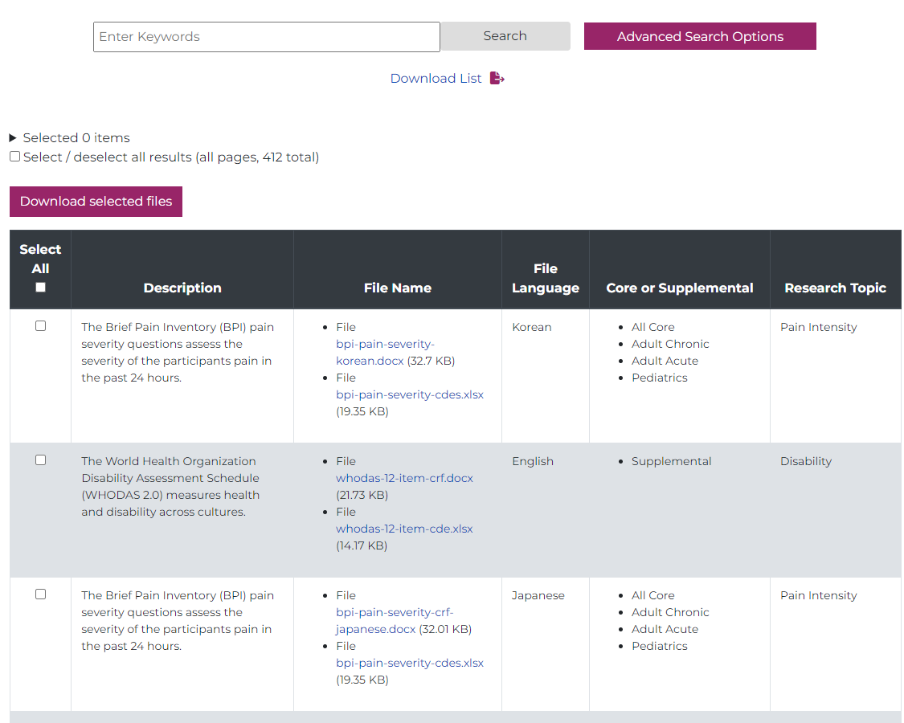
Demonstration: HEAL CDE Repository
Link to repository: https://heal.nih.gov/data/common-data-elements-repository
Locate CDEs and Case Report Forms (CRFs)
  Instructions on obtaining copyrighted CDEs*
Utilizing the search functions
Questions? Contact heal_cde@hsc.Utah.edu
Notes:
Now, I am going to show you the HEAL CDE public repository.
First, I am going to show you the display of these PROMS. We will review the adult demographics PROM as it was described in a previous slide.
Explain the columns.
Explain CRF and open.
Explain CDE and open.
Explain the search by text (Migraine)
Explain the advance search
Explain Copyright Statement and open.
Copyrighted form
As you can see here, we have the name of the PROM, and instructions on how to obtain the license or permission of the PROM. Once your study team has obtained the license or permission, email the HEAL CDE email listed here, and they will send you the CDEs. I do want to note, that if you are a HEAL funded grantee, studying pain in human subjects, the HEAL CDE team will purchase the copyright licenses or the core Case Report Forms. However, these studies will be responsible for purchasing the licenses for any copyrighted supplemental questionnaire. Lastly, you will also see that languages we have available for the form. In this case, we have only the english case report form available.

Slide 19
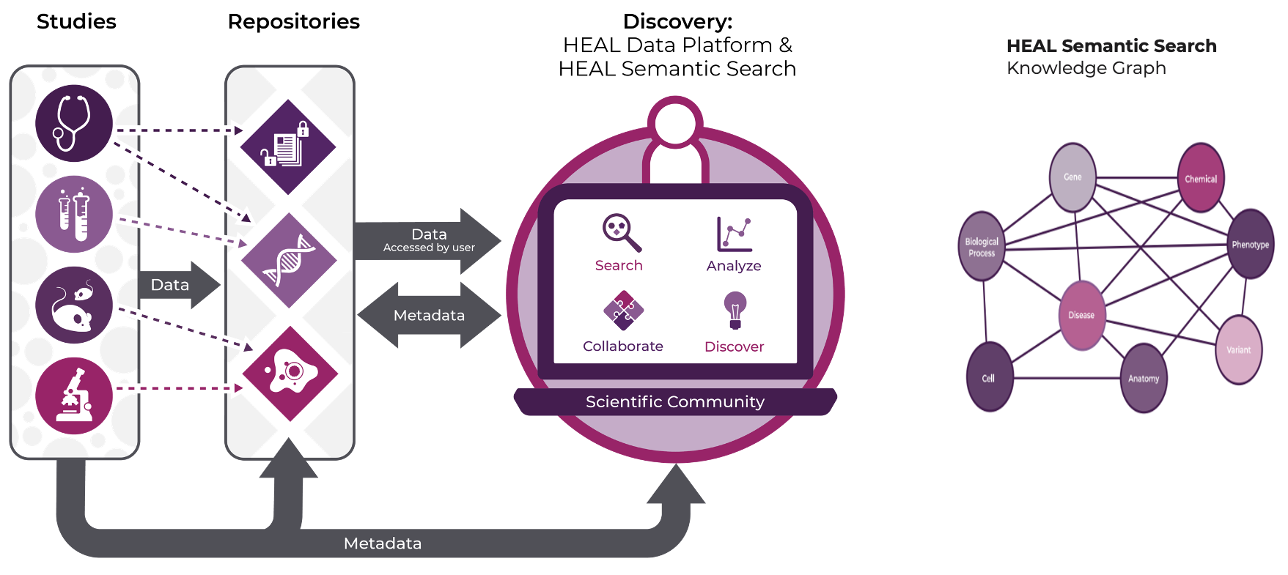
HEAL Data Ecosystem Strategy and Tools
Notes:
The charge of the Data Ecosystem
Thank you so much Giulia and Carolyn, and hello everyone. My name is Anthony Juehne and I serve as the program manager and data scientists overseeing the HEAL Data Ecosystem under the direction of Dr. Jess Mazerik.
I want to begin with a few summary level-setting points, then dive into the overall strategy and design of the HEAL Data Ecosystem.
HEAL is charged with incentivizing data sharing and data reuse to expedite discoveries addressing substance use and chronic pain.
The HEAL CDEs support implementation of clinical concepts and measures in a standardized way for all human clinical investigator teams.
These CDEs support harmonization and comparison of these measures across teams and the resources provided in the HEAL CDE repo support easy implementation of the HEAL CDEs within diverse data collection and management pipelines.
One key takeaway I hope to frame today is that as HEAL studies begin to share their data, rigorous (meta)data curation is crucial for both data discovery and reliable data (re)use and we’re carefully incorporated the HEAL CDEs into our overall metadata strategy.
One overarching principle in the development of the HEAL Data Ecosystem is to make it as easy as possible for both those sharing data and those reusing data to get those most value out of the data coming from HEAL studies.
Repositories: Heal-funded studies are required to deposit their data in one of the 26 HEAL compliant repositories for long-term storage, many of which offer domain or data-type specific curation support and ethical governance. The HEAL Data Stewards have carefully defined this repository list and provide direct support to help HEAL investigators determine the repository most appropriate for their study.
The HEAL Data Platform is a data mesh providing a structured environment wherein users can search, discover, access, and analyze data from NIH HEAL-funded studies stored in these external repositories. The Platform does not directly store HEAL data but supports multiple use cases for diverse user groups:
Search: Users can search studies on the platform, gaining access to detailed information, including study specific CDEs being collected, as well as the access the study’s data and associated digital artifacts such as protocols and analysis code.
Analyze: Platform users can conduct secondary data analysis across studies leveraging CDEs to uncover insights at the intersection of pain and addiction.
Collaborate: Collaborate with other researchers and studies working on similar topics or using similar CDEs.
Discover: Search for HEAL studies and related datasets and analyze them within a specific workspace.
Data Exploration: The HEAL Data Platform and HEAL Semantic Search Knowledge Graph offer robust tools for exploring data, supported by detailed metadata. These tools provide deeper insights into how data points are connected, helping researchers understand relationships between studies, datasets, and CDEs.

Slide 20
What are Metadata?
Study identifiers (Study-level Metadata)
Name: SPRINT (Signature for Pain Recovery IN Teens)
Project Number: 1R61NS114926-01
Research Focus Area: Preclinical and Translational Research in Pain Management
PI: Laura E. Simons
Institutions: Stanford University
Administering ICs: NINDS
Year Grant Awarded: 2019
Concepts/Variables measured in SPRINT
Name
Date of Birth
Age
Ethnicity
…
…
Pediatric Anxiety
Fatigue
Chronic Pain Acceptance
…
…
Pressure Pain Threshold_Shoulder
Pressure Pain Threshold_Knee
…
Variable-level Metadata (data dictionaries)
Date of Birth | Variable Name | Label | Field Type | Permissible Values
 | brthdtc | Date of Birth (MM/DD/YYYY) | Text
HEAL Supplemental CDE
Pediatric Anxiety SF8a [PROMIS]
HEAL CDE Repo link
Pediatric Anxiety | Variable Name | Label | Field Type | Permissible Values
 | ppanx1 | I felt like something awful might happen | Radio | 1,2,3,4,5
 | ppanx2 | I felt nervous | Radio | 1,2,3,4,5
 | ppanx3 | I felt scared | Radio | 1,2,3,4,5
 | ppanx4 | I felt worried | Radio | 1,2,3,4,5
 | ppanx5 | I worried when I was at home | Radio | 1,2,3,4,5
 | ppanx6 | I got scared really easy | Radio | 1,2,3,4,5
Notes:
Metadata are the crucial driving force for the HEAL Data Ecosystem. The HEAL Platform leverages multiple-levels of metadata to power search and discovery tools supporting Platform users in finding studies and data of interest to their needs, as well as harmonizing and analyzing data.
This slide demonstrates the levels of metadata and how they are hierarchically related.
From higher-level Study-level metadata describing the research focus area and cohort characterists -> Variable-level metadata describing individual study data elements (think of this as a data dictionary)-> to CDE and related semantic information which support linkage of case report forms, biomedical concepts, and semantic standards.
One major goal is to make the process of provisioning this metadata as simple and streamlined as possible, thus the HEAL Platform leverages metadata from multiple external sources, including Clinicaltrails.gov and NIH Reporter, and links directly to the HEAL CDE repo to both support CDE variable-level metadata curation and traceability to the CDE repo materials supporting implementation and reuse.

Slide 21
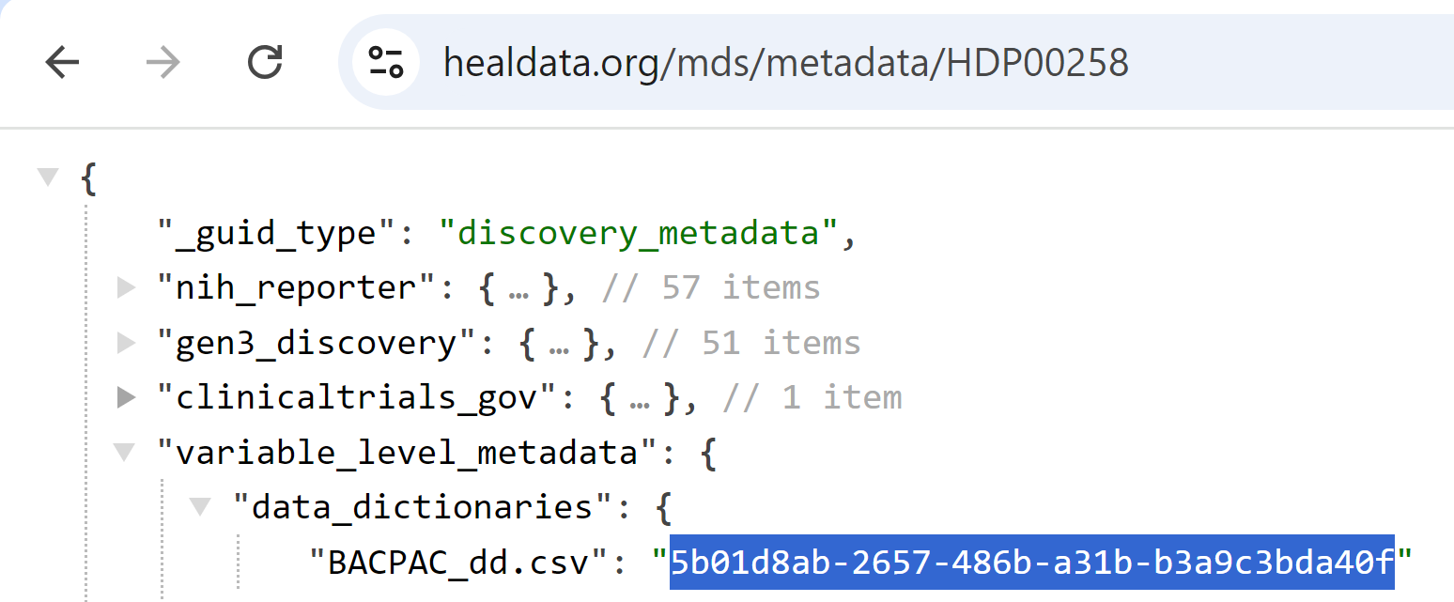
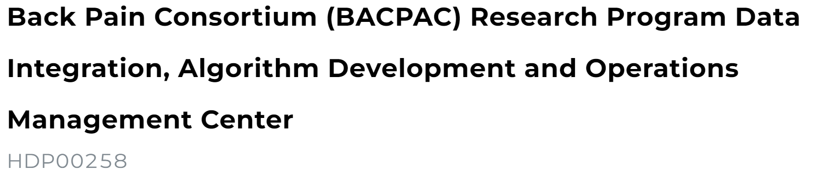
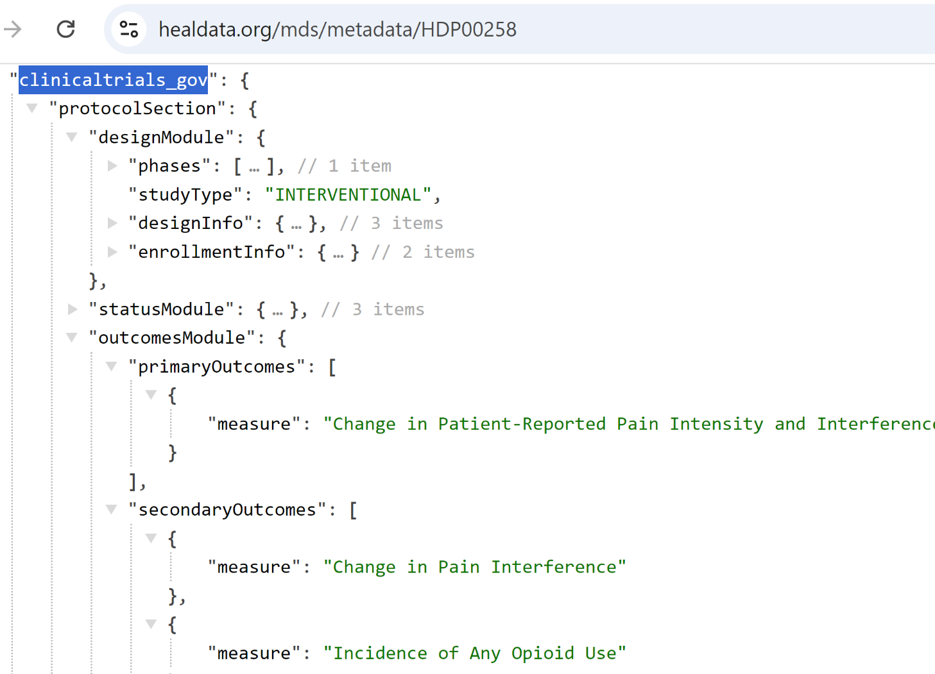
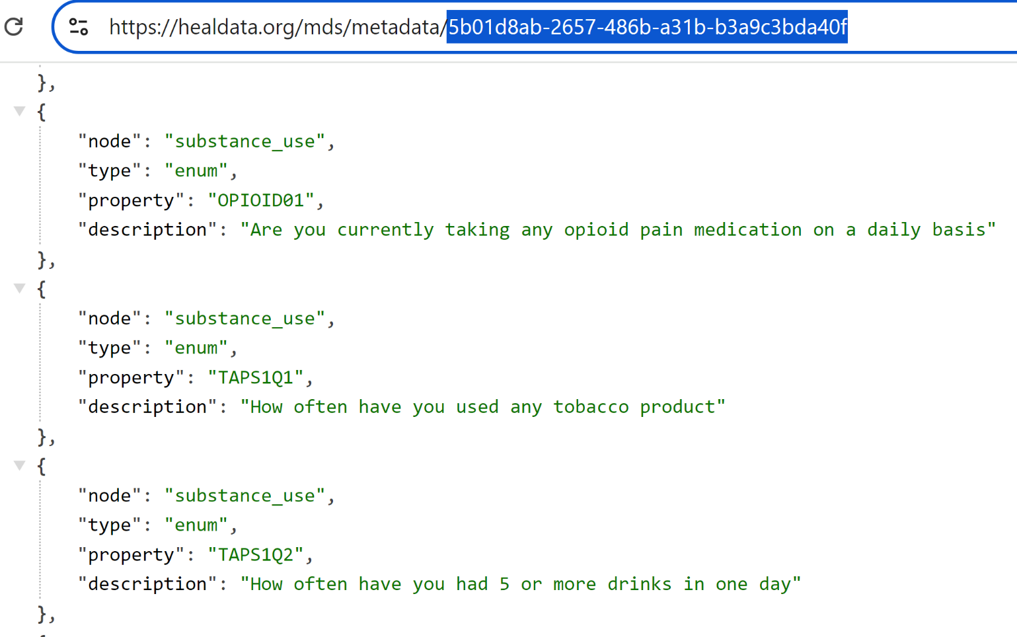
The Value of Metadata
Notes:
Let’s take a quick look at what can be achieved with these metadata by diving into the BACPAC study on the Platform.
From this study’s metadata record, we can quickly determine it’s a mutli-site human clinical trial implementing an intervention chronic low back pain measuring the secondary outcome of change in opioid medication use.
By diving into the variable level metadata record for this study, we can see they used an extended version of the TAPS CDE with an additional element measuring daily opioid pain medication use at multiple time points in the study.

Slide 22
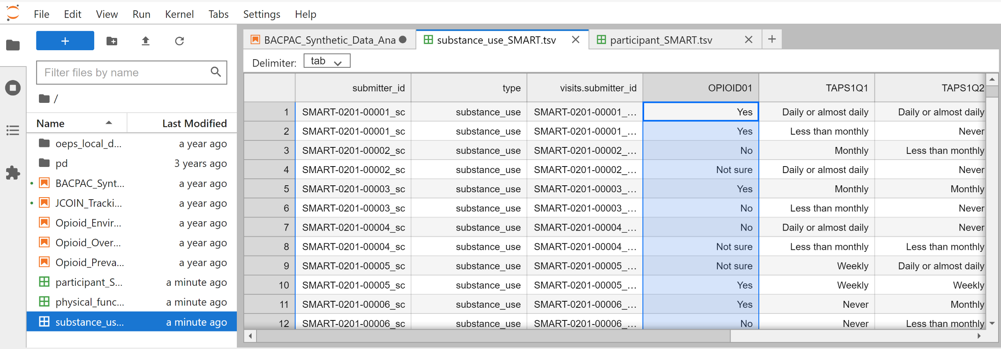
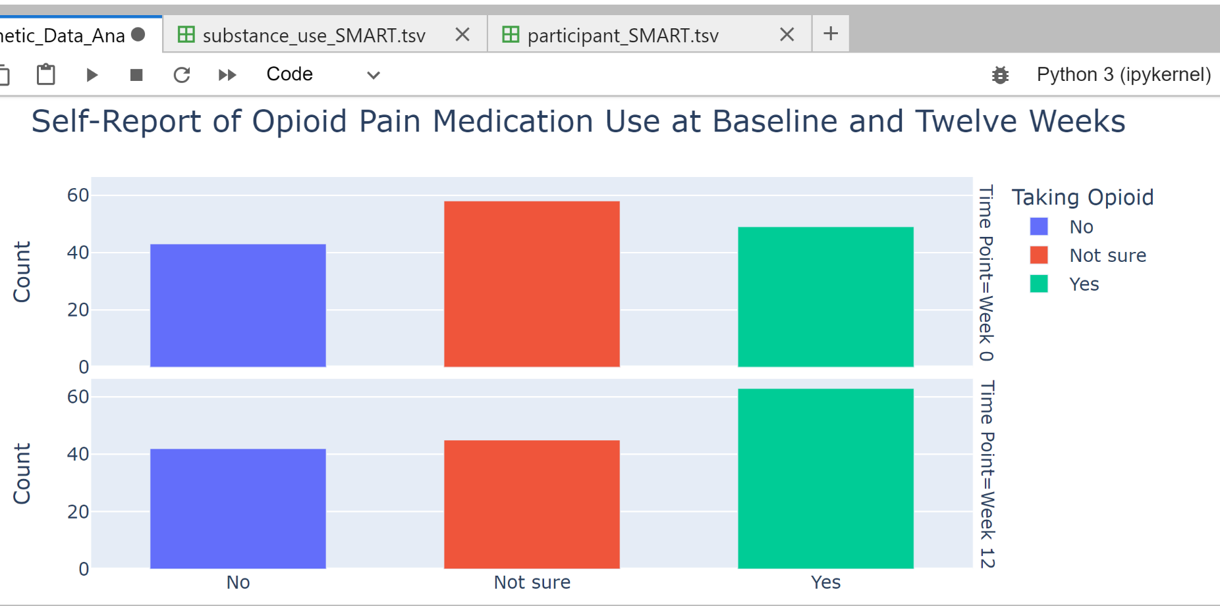
Variable-level metadata provides rich context for exploring study data elements
Reliably conduct analysis in Platform workspaces leveraging rich data, metadata, and computational resources
HEAL Data Platform
https://healdata.org/landing
HEAL Ecosystem GitHub:
https://github.com/HEAL
HEAL Data Stewards
www.healdatafair.org/
Fresh FAIR webinar series: https://www.healdatafair.org/webinar
Notes:
When we pull these BACPAC data into a Platform workspace, the VLMD shown in the previous slide allow us to more readily understand what “OPIOD01” means and thus we can more reliably work with this data when building and interpreting our analysis. In addition, these VLMD support more reliable data harmonization and comparison across teams, as well as the opportunity to build larger more generalizable models of pain and addiction driven by more reliable data.

Slide 23
Key Takeaways
Biopsychosocial Model: Pain research should assess biological, psychological and social factors.
Core CDEs: HEAL has developed a core set of standardized CDEs for pain studies involving human subjects
  Customizing Study Outcomes: Researchers can select additional outcomes based on needs of their study and population(s) .
  The HEAL CDEs do not have to be the primary outcome of your study.
Benefits of CDEs for Research and Data Comparison
  Standardized CDEs enable data harmonization, helping researchers understand pain treatments by comparing results across studies.
  HEAL's Data Ecosystem supports secondary data analysis, allowing for comparisons of outcomes, conditions, interventions and populations across HEAL-funded research.
Importance of early data harmonization: Extra effort up front to align outcomes and PROMS leads to:
  Easier data comparison across studies
  More effective analysis of study results
  Enhanced Treatments for pain
Notes:
To recap what we have covered in this lesson, we would like to emphasize the importance of the biopsychosocial model of pain when considering assessment for pain research.
The NIH HEAL Initiative considered pain holistically when developing the core CDEs, which is a set of standardized patient-reported outcomes and questionnaires that all HEAL-funded PIs studying human subjects must measure. However, researchers are expected to measure additional outcomes that are specific or relevant to their study aims, populations, or interventions.
The HEAL CDE program was created to enable data harmonization for the field of pain research, so that study results can be more easily compared to better understand and improve pain treatments moving forward. To support this goal, the HEAL Data Ecosystem is also a very useful tool to support secondary data analyses because it allows anyone to search for data that has been uploaded by HEAL investigators. Users can search for studies based on outcomes, health conditions, interventions, or populations, among other variables.
With the HEAL CDE program, through both the core CDEs and supplemental CDEs, our goal is to put in the work now to align outcomes and questionnaires for improved data harmonization so that in the future researchers and other stakeholders can more easily compare data across studies, perform statistically significant analyses of study results, and enhance pain treatments.

Slide 24
Helpful Links:
NIH HEAL Common Data Elements Webpage
NIH HEAL CDE repository
HEAL Data Ecosystem
HEAL Data Platform
Search the Data Ecosystem
Discover related biomedical concepts, studies, or variables
HEAL Platform Tutorials
National Library of Medicine CDE Repository
NINDS Case Report Form (CRF) Repository
National Institute of Mental Health (NIMH) Data Archive (NDA) CDE Requirements
National Institute of Drug Abuse (NIDA) Clinical Trials Network (CTN) recommended CDEs
Notes:
Thank you very much for taking the time to learn about the HEAL CDE program. Here we have provided a list of links and tools related to the HEAL CDE program and the HEAL Data Ecosystem, as well as other NIH resources and CDE requirements from other institute and centers.

Slide 25
Relevant Webinars/Resources:
Webinar: Common Data Elements (CDEs): Getting More Common All the Time
Webinar: Advancing Open Science with the HEAL Data Ecosystem
Notes:
Additionally, these webinars dive further into the HEAL CDE program and Data Ecosystem.

Slide 26
Resources for HEAL-Funded PIs
Webinar: Hands-on HEAL Data Sharing Requirement Guidance
Webinar: Crafting a HEAL-Compliant Data Management and Sharing Plan
Webinar: Register your Study with HEAL
Tutorial: HEAL Data Platform Study Registration - Step 1 of 2
Tutorial: HEAL Data Platform Study Registration - Step 2 of 2
Webinar: Sharing Data in HEAL-Compliant Repositories: Requirements and Guidance
Notes:
For HEAL-funded researchers, these webinars and tutorials provide information about data sharing requirements and processes for registering and uploading your data to a HEAL-compliant repository.

Slide 27
Want more information?
HEAL Common Data Elements:
HEAL Data Ecosystem:
HEAL Pain CDE Program Managers: heal_cde@hsc.utah.edu
Giulia Bova: Giulia.bova@nih.gov
Carolyn Conlin: Carolyn.Conlin@nih.gov
Laura Wandner: Laura.Wandner@nih.gov
HEAL Stewards: HEALStewards@renci.org
HEAL Data Platform: heal-support@gen3.org
Notes:
Lastly, if you have any follow-up questions about anything you heard today, we have listed the contact information for the HEAL CDE Program staff and the HEAL Data Ecosystem.

